Slide 1
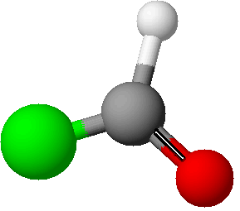
Derivatives of Acid Chlorides

Slide 2
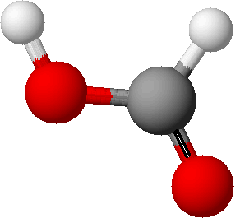
Derivatives of methanoyl chloride
What else can be used to convert a
carboxylic acid to an acid chloride
What is produced?
PCl₅ or
Methanoic
Acid
Methanoyl
chloride
SOCl₂
HCOOH
HCOCl

Slide 3
Derivatives of methanoyl chloride
What is the product?
Methanoyl
chloride
H₂O
Methanoyl
chloride
Methanoic
Acid
What is the product?
NH₃
Methanamide
What is the product?
Methanoyl
chloride
ethanol
ethyl
methanoate

Slide 4
This powerpoint was kindly donated to www.worldofteaching.com
http://www.worldofteaching.com is home to over a thousand powerpoints submitted by teachers. This is a completely free site and requires no registration. Please visit and I hope it will help in your teaching.

